Slide 1

Heart Disease Prediction System
This project uses machine learning to predict heart disease. We'll explore data preprocessing, model implementation, and performance evaluation.

Slide 2
1
Patrick Nassef Ghais
2
Reham Ashraf Fathy
3
Saif Eldin Sameh
patrick.nassef69@gmail.com
rehamashrf100@gmail.com
saifeldinsameh@gmail.com
4
Tarek Muhammed Abdel-Hamid
5
Yassin Saad Elasfar
tarekkmuhammed1911@gmail.com
yassenelasfar@gmail.com

Slide 3

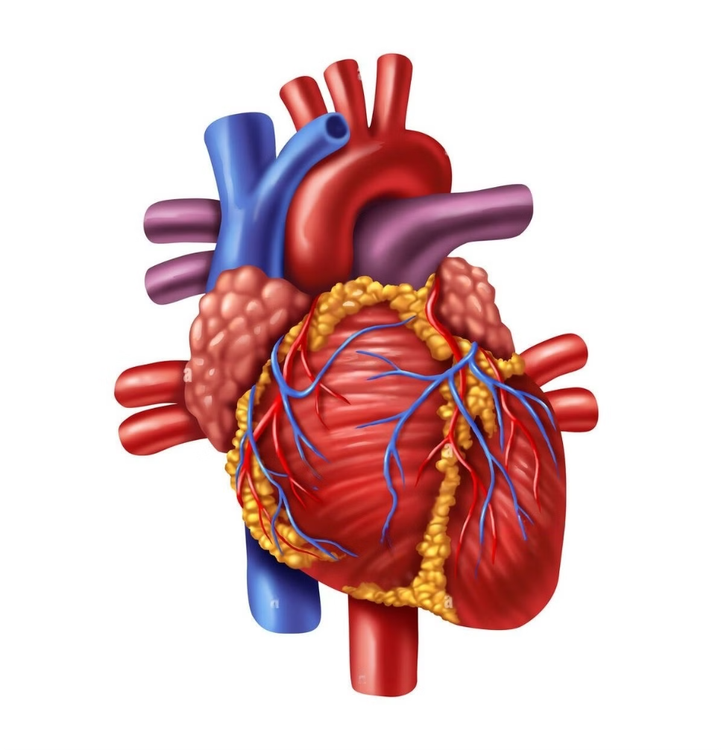
Introduction to Heart Disease
Heart disease remains the world’s leading cause of death, claiming millions of lives each year. Early diagnosis is crucial, yet traditional methods often fail to detect risks in time, leaving patients vulnerable to severe outcomes.
A breakthrough in medical diagnostics has emerged—leveraging machine learning to analyze key medical indicators and predict heart disease with remarkable accuracy. This cutting-edge system integrates advanced algorithms with patient data, offering healthcare professionals a fast, reliable tool to identify at-risk patients and enable life-saving interventions.
This presentation will explore the development of a robust, AI-driven solution, from data acquisition and preprocessing to model deployment, and how this innovation could change the future of heart disease detection.

Slide 4




Problems of Heart Disease
High Mortality Rate
Delayed Diagnosis
Complexity of Risk Factors
Class Imbalance in Data
Heart disease is a leading cause of death, with millions of lives lost annually due to late diagnoses and lack of timely intervention.
Many patients do not receive a diagnosis until the disease has progressed, increasing the risk of severe complications and reducing treatment effectiveness.
Heart disease is influenced by various factors—age, lifestyle, genetics, and medical history. Traditional methods often fail to consider the full spectrum of these variables.
Medical datasets frequently show significant class imbalance, with a much larger number of individuals without heart disease compared to those with it, leading to biased predictions.

Slide 5
Solutions Provided by the Application
1
Early Detection and Prediction
The application leverages advanced machine learning algorithms to analyze patient data, enabling earlier detection of heart disease and timely intervention.
2
Multi-Model Analysis
By integrating multiple machine learning models—SVM, Logistic Regression, XGBoost, and Random Forest—this system ensures higher accuracy and reliability in predictions, addressing the complexity of risk factors.
3
Class Imbalance Mitigation
To combat class imbalance, the application employs techniques like SMOTE to generate synthetic samples for underrepresented classes, resulting in more balanced predictions.
4
User-Friendly Interface
Healthcare professionals can easily input patient data into a straightforward interface, receiving instant predictions that aid in quick decision-making.

Slide 6

Collecting and Preprocessing the Data
1
Data Acquisition
Gather relevant patient data from reliable sources.
2
Data Cleaning
Handle missing values, outliers, and inconsistencies.
3
Feature Engineering
Create new features to improve model performance.
4
handling imbalanced data
Scale or normalize data for optimal model training.

Slide 7

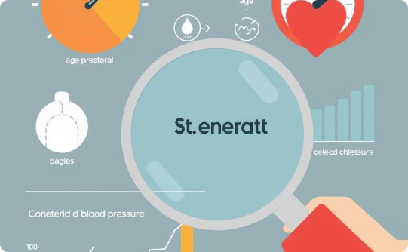

Data Acquisition
Source
Dataset Size
Importance
We acquired the dataset from Kaggle, specifically the 'Indicator of Heart Disease' dataset, updated in 2022. This dataset is widely used in medical research, making it a reliable source for our model.
The dataset includes thousands of records, each with several key medical features such as age, cholesterol, blood pressure, chest pain type, and more.
Using a credible dataset is crucial for accurate machine learning predictions, especially in healthcare where the data needs to be accurate and relevant to real-world scenarios.

Slide 8


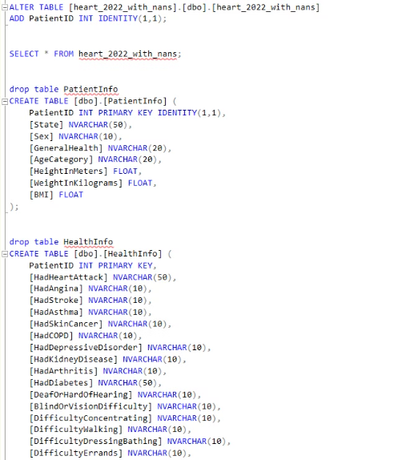
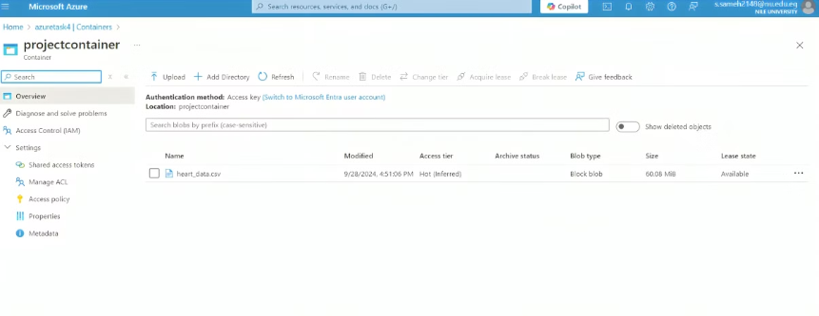
Data Cleaning
SQL
Azure Data Warehouse
We used Microsoft SQL Server to add patient IDs and remove null values.
After cleaning the data in Microsoft SQL Server, we uploaded the new CSV file to Azure Data Warehouse.

Slide 9
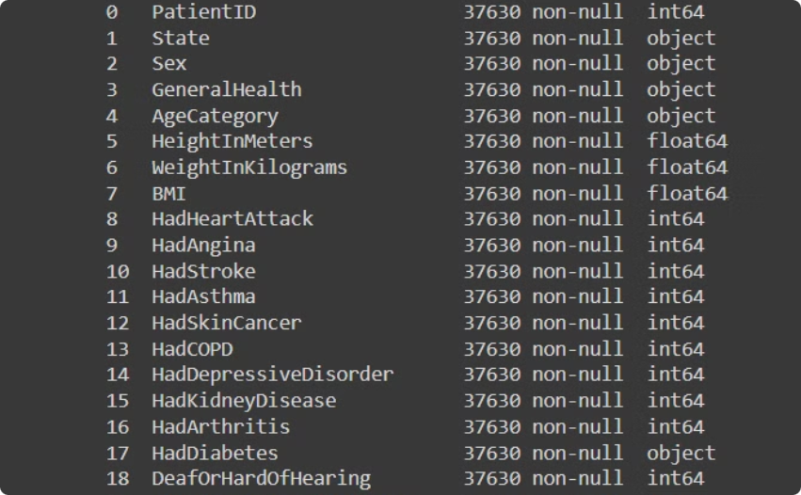
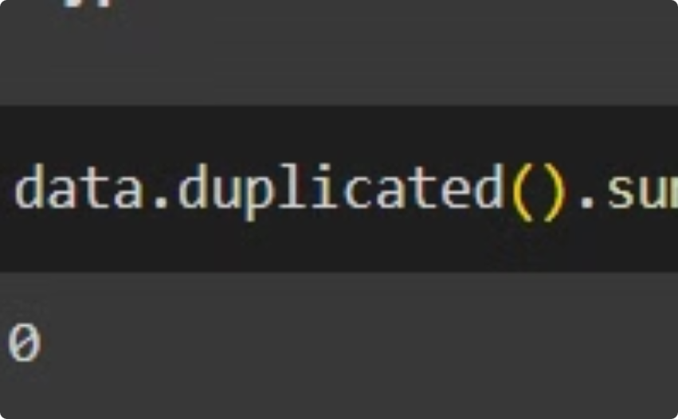
Data cleaning
3) python colab:
Data Type Inspection
Duplicate Removal
In Python Colab, we imported the data from our Azure Data Warehouse and performed a thorough inspection of the data types. This ensured we had a clear understanding of the data we were working with, which is crucial for accurate analysis.
After inspecting the data types, we identified and removed any duplicate entries. This step is critical for maintaining the integrity and accuracy of our analysis, ensuring reliable and valid results.

Slide 10
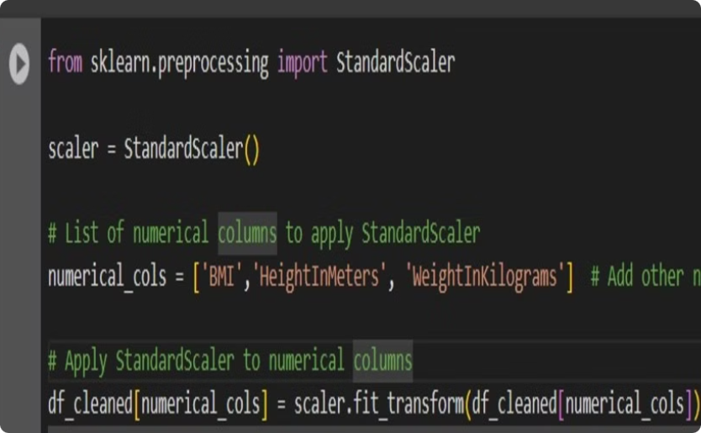
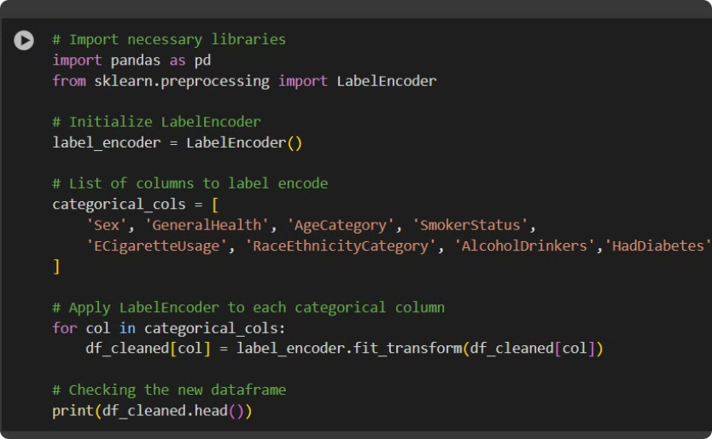
Feature Engineering:
Scaling
Encoding Categorical Variables
We used a standard scalar to normalize our numeric columns, such as height, BMI, and weight. Normalization ensures that all features are on a similar scale, improving the performance of our machine learning models.
We used label encoder to convert our categorical features into numerical values. This is a common technique in machine learning, as models can only work with numerical data.

Slide 11
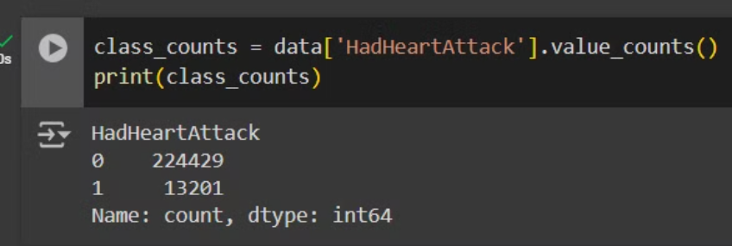
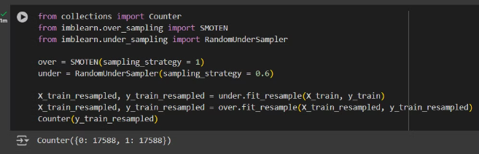
Handling imbalanced data
Oversampling
before sampling:
To address the imbalance in our dataset, we employed a combination of oversampling and undersampling techniques. We used SMOTEN (Synthetic Minority Over-sampling Technique for Nominal features) to increase the number of instances in the minority class (patients who had a heart attack). This involved creating synthetic data points that were similar to the existing minority class samples.
Undersampling
after sampling:
Subsequently, we applied random undersampling to the majority class (patients who didn't have a heart attack) to reduce its size and bring it closer to the oversampled minority class. This approach ensured a more balanced dataset for training our machine learning models, leading to improved prediction accuracy and reducing bias.

Slide 12
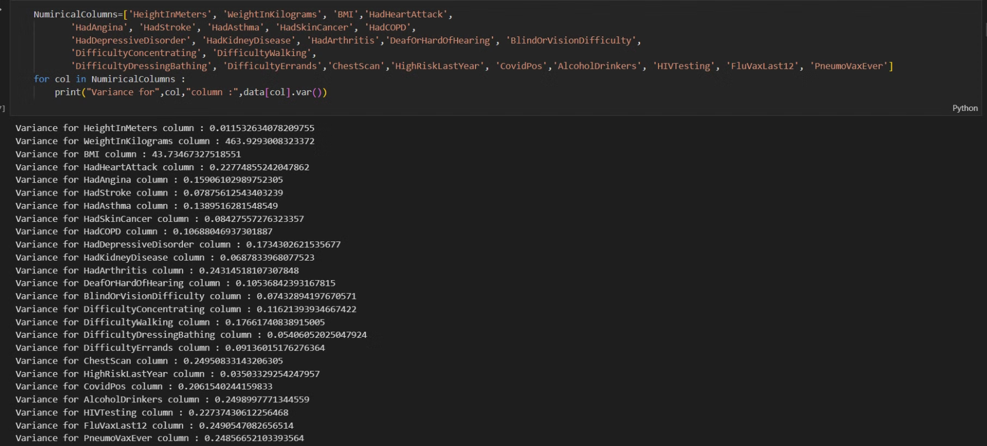
Exploratory Data Analysis
Descriptive Statistics
Many types of Statistical Analysis , one of them is the Variance

Slide 13
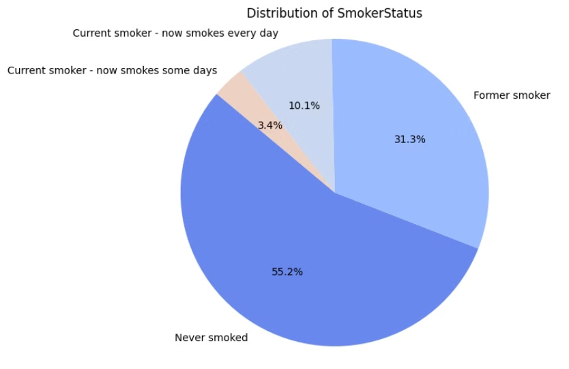
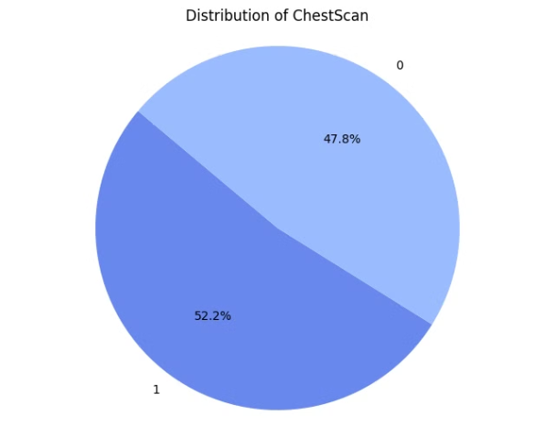
Exploratory Data Analysis
Data Visualization
Using Pie-Chart to show the percentages of clusters of each features

Slide 14
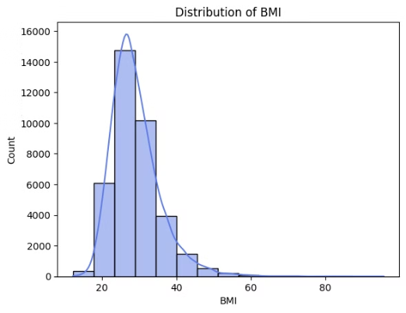
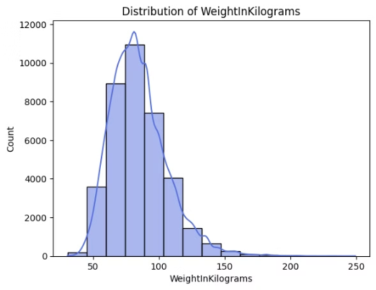
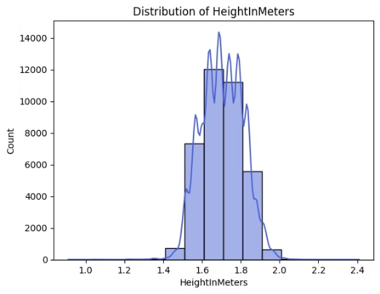
Using bar-Chart to show the distributions of the data and its skew

Slide 15
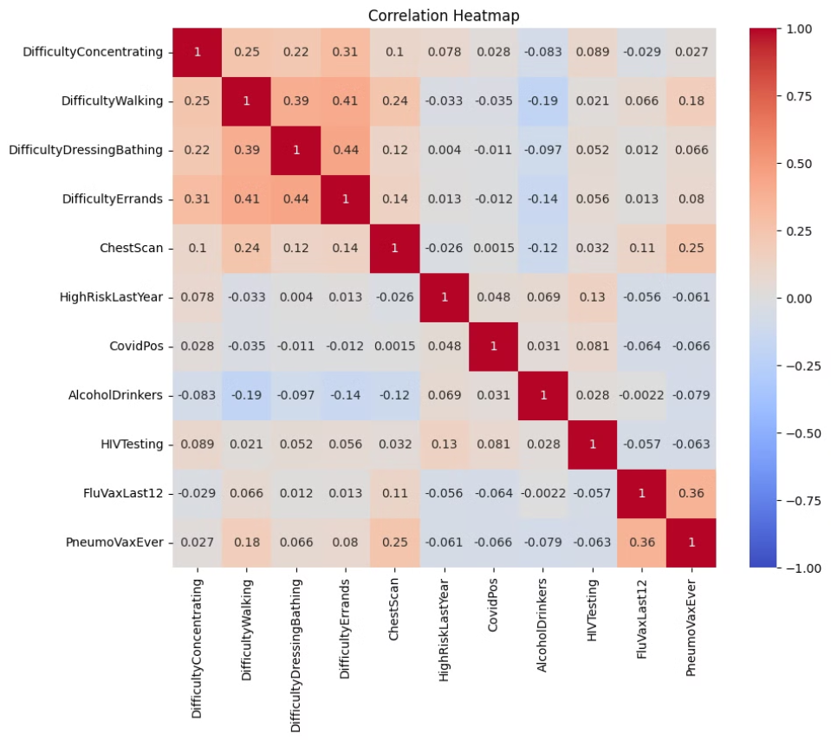
Using Correlation Heat map to show the dependence of the features

Slide 16





Implementing Four Machine Learning Models
SVM Model
Random Forest Model
Logistic Regression Model
XGBoost Classification Report

Slide 17






SVM Model
83%
86%
76%
Accurcy
precision-0
precision-1
88%
73%
76%
75%
recall-0
recall-1
f1-score-0
f1-score-1

Slide 18





Random Forest Model
81%
85%
75%
Accurcy
precision-0
precision-1
87%
72%
86%
74%
recall-0
recall-1
f1-score-0
f1-score-1

Slide 19



Logistic Regression Model
82%
83%
82%
Accurcy
precision-0
precision-1
92%
64%
87%
72%
recall-0
recall-1
f1-score-0
f1-score-1

Slide 20
XGBoost Classification Report
82%
86%
74%
Accurcy
precision-0
precision-1
86%
74%
86%
74%
recall-0
recall-1
f1-score-0
f1-score-1

Slide 21
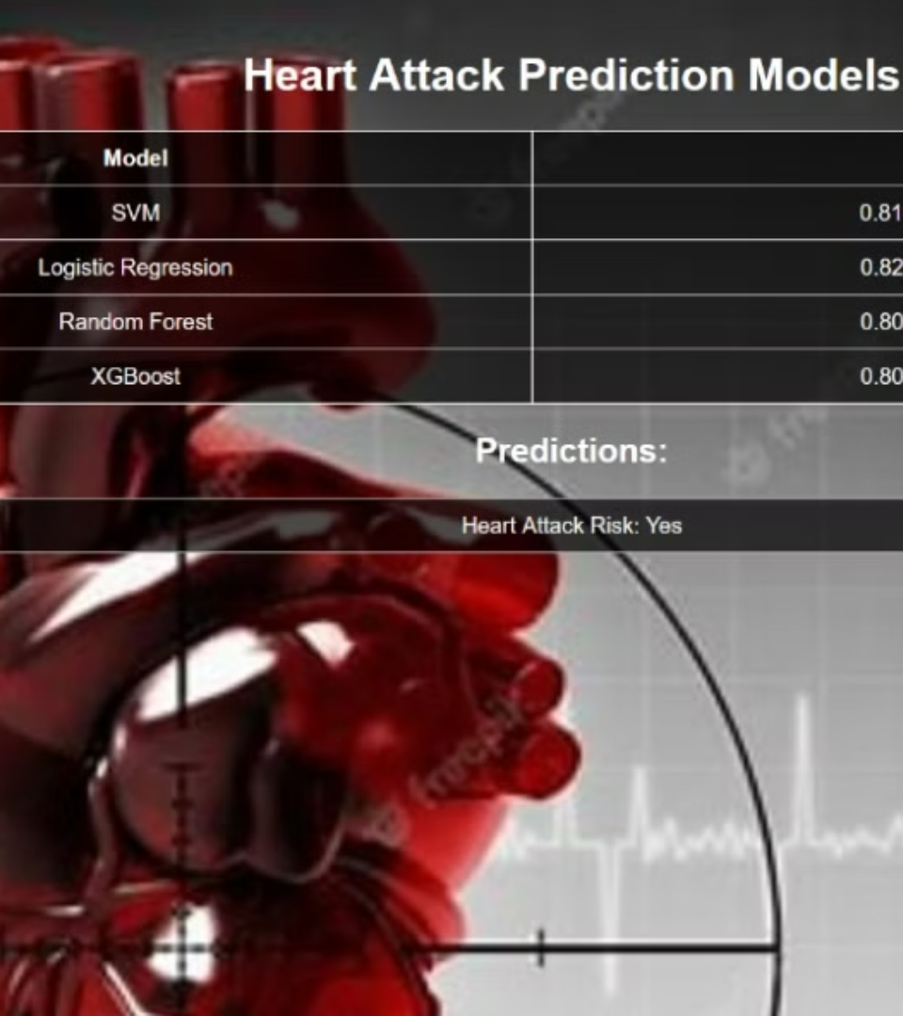
Calculating the Average Accuracy
The average accuracy across the four models is approximately 82.25%. This demonstrates the effectiveness of the approach.

Slide 22

Conclusion
the Heart Disease Prediction System represents a significant advancement in the way heart disease can be detected and managed. By leveraging machine learning algorithms and addressing key challenges such as delayed diagnoses and data imbalance, this innovative application empowers healthcare professionals to make informed, timely decisions that can save lives.
The integration of a user-friendly interface ensures that essential patient data can be easily inputted, allowing for immediate risk assessments and proactive interventions. With the potential to revolutionize early detection in heart disease, this system not only enhances patient care but also contributes to a broader goal of improving healthcare outcomes.
As heart disease continues to pose a serious threat globally, the need for reliable, data-driven solutions is more critical than ever. Thank you for your attention, and I welcome any questions or discussions on how this technology can be further developed and implemented in real-world healthcare settings.

Slide 23

Thank you!
We appreciate your time and interest.

